Slide 1
Unsupervised Learning
Team 16 - Chai Hibbert, James Davies, Solomon Itany

Slide 2
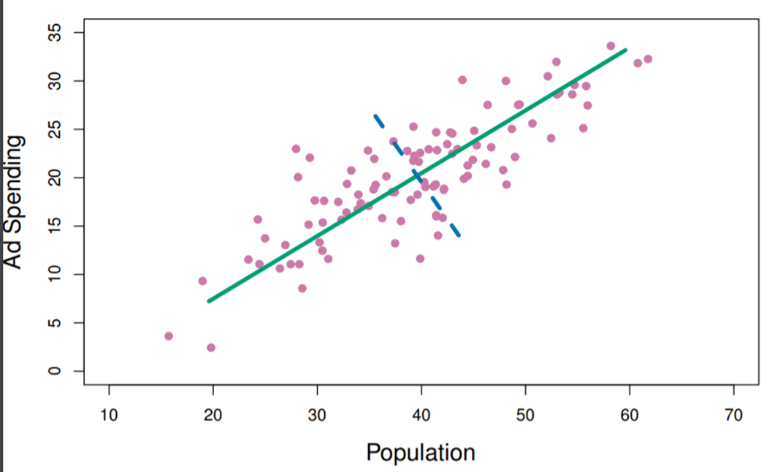

Principal component Analysis
Principle components are computed and used to understand underlying patterns in data.
Seeks a small number of dimensions that are interesting as possible and a linear combinations of p features
The first principle component is a set of normalized linear combination of features that have the largest variance.
Loading are constrained to a sum of squares of one
The second PC also finds maximum variance in the data, but is uncorrelated with the first PC, yielding a orthogonal direction.
Process repeated based on the number of dimensions

Slide 3
K-Means clustering
Partitions a data set into K distinct, non-overlapping clusters / homogeneous subgroups
K-Means Algorithm
Randomly assign a number, from 1 to k to each of the observations which serve as initial cluster assignments
For each k cluster, compute cluster centroid (mean of observations assigned to each cluster)
Assign each observation to the cluster whose centroid is closest & minimize the total within-cluster variations
Euclidean distance
Iterate until a local optimum has been reached/ when the result nologer changes
Run the algorithm nstart times to select the best solution i.e for which objective is smallest.

Slide 4
Hierarchical clustering
Merges observation/ data points into subgroups on the basis of similarity/ dissimilarity
Hierarchical clustering Algorithm
Define a dissimilarity measure
Euclidean distance
Manhattan distance
correlation-based distance
Each Observation treated as a cluster at bottom of dendrogram
Two clusters that are most similar are fused together
Complete
Single
Average
Centroid
Iteration until the dendrogram is complete
Linkage

Slide 5
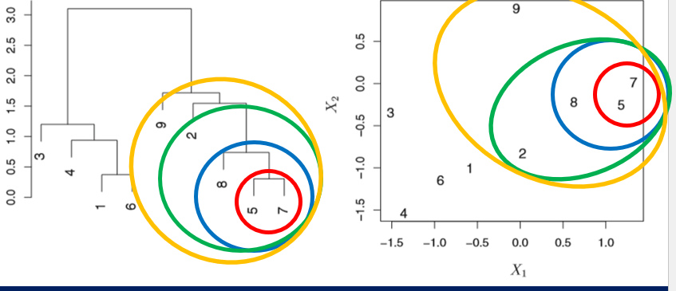
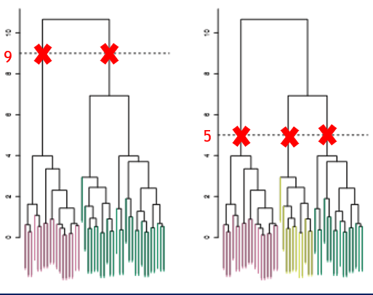
Hierarchical clustering

Slide 6
R Code
Problem Objective
Creating random data
Principal component analysis
K means clustering
Scaling data
Notes:
James

Slide 7
Python Problem
Objective:
Simulate random data to test PCA
Testing accuracy with K means clustering
Libraries Used:
numpy
pandas
sklearn (PCA)
KMeans (KM)

Slide 8
Quiz Time!
Link to quiz goes here: https://quizizz.com/admin/quiz/643472c461b795001d8ddbb0?source=quiz_share
Notes:
James

